Slide 1
Implementation
Database In
AL-HIDA Drug Store
Alfi Naufal
Hilman Maulana Anhar
M Dani Setiawan
1SC8

Slide 2
INTRODUCTION
AL-HIDA is taken from our name Alfi, Hilman, and Dani. A Drug Store
Networking, also known as computer networking, is the practice of transporting and exchanging data between nodes over a shared medium in an information system. Networking comprises not only the design, construction and use of a network, but also the management, maintenance and operation of the network infrastructure, software and policies.
And In this project, we asked to design a network system. Therefore we choose to design an Office’s Network System. In this paper our group will explain how to create such network.

Slide 3
HADWARE
Hardware is a set of components in a computer whose job is to make the computer work. Or in other words hardware can also mean computer devices that can be touched, the contents are related to computer work systems.

Slide 4
SOFTWARE
Software is a collection of electronic data stored and regulated by a computer, electronic data stored by a computer can be a program or instruction that will execute a command. It is through software or software that a computer can execute a command.

Slide 5
What is ?
Network Architectures
Network Topology
Identifying Computer On A Network
Network architecture is the procedure for using hardware and software in a network so that one computer with another computer can communicate and exchange data. Network Architectures in general can be described into three categories : Client Server , Peer To Peer And Hybird
Network topology is a way or concept to connect multiple or many computers at once into a network that is interconnected. Network topology in general can be described into five categories for example : Topology Bus , Topology Star , Topology Ring , Topology Mesh , Topology Tree
Any computers on a network can be identified by this two following method :
IP Address is a numerical label assigned to each device connected to a computer network that uses the Internet Protocol for communication.
MAC Address is a network address that is implemented in the data link layer in seven layers of the OSI model, which represents a particular node in the network

Slide 6
Network Analysis
This Project is consists of Building a Network System at Office for creating ease access between each Employees or even Visitor. The Network Blueprints of the Office contains 1 CEO Room, 1 Receptionist Room, 2 Employees Room, and 1 Server Room. The Office’s CEO wants to create a Single Floor network that each employees can communicate via network.

Slide 7
What We Use?
Network Architectures
Network Topology
Network Device
In this Project, the architecture that will be used in the Network is Client-Server Architecture, Client/server is a program relationship in which one program (the client) requests a service or resource from another program (the server).
Because of there is lot of room in the Office, the Network requires a combination of more than one Topology. Based on that fact, the Network will use Hybrid as the Topology of the Network.
There are lot of network devices with various functionality, however, the Office’s Network needs these Devices :

Slide 8
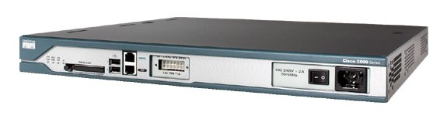
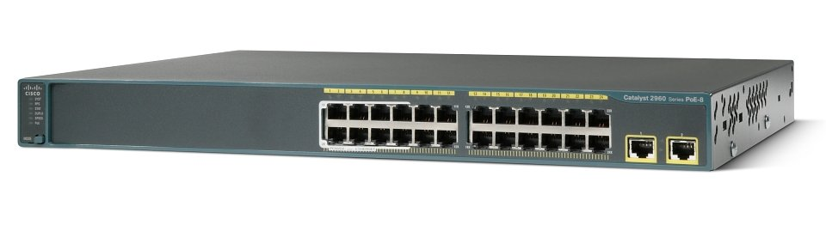
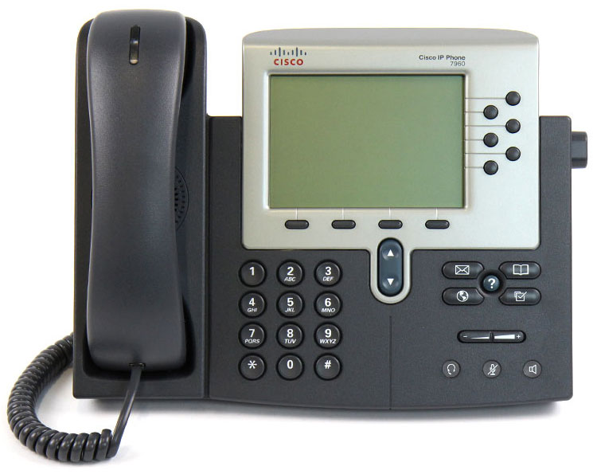
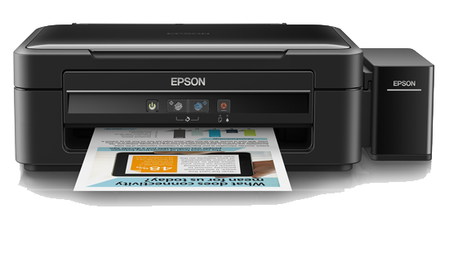
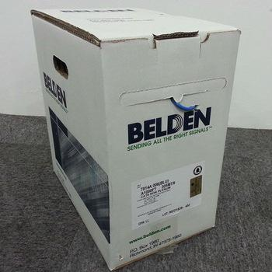
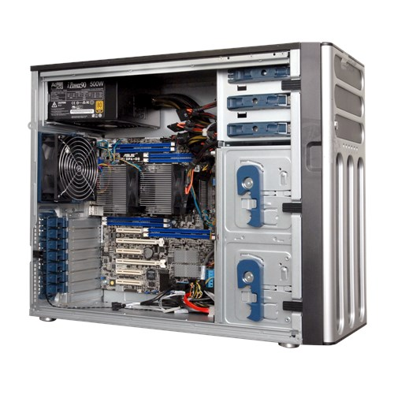
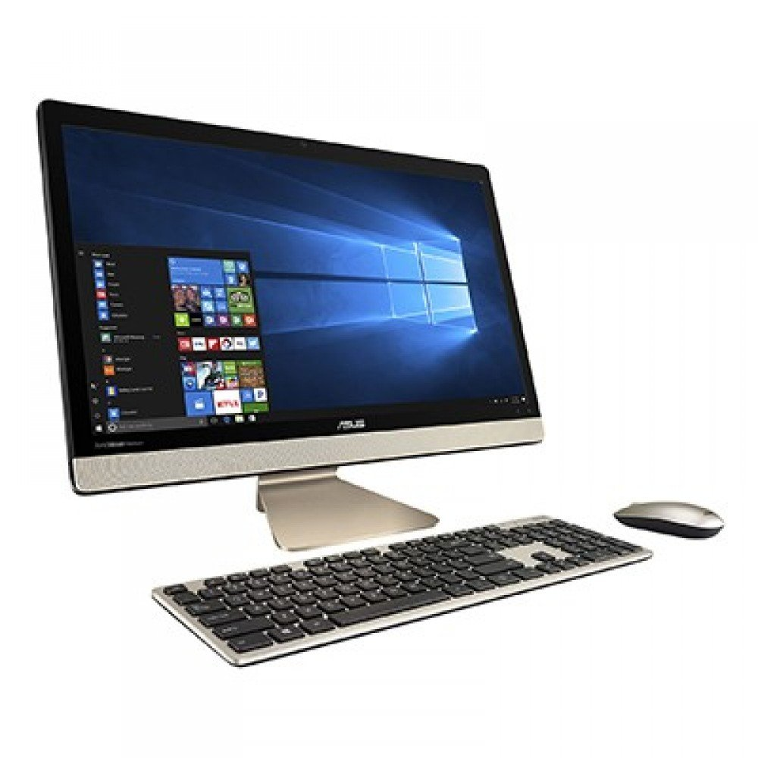
Network Device
1x Cisco 2811 Router
4x Cisco 2960 Switch
2x Cisco 7960 IP Phone
5x Belden CAT5E
305 Metres UTP Cable
12x Asus AiO V220ICGT-BG017X
2x Epson L360 Printer
1x Asus Server TS500-E8/PS4

Slide 9
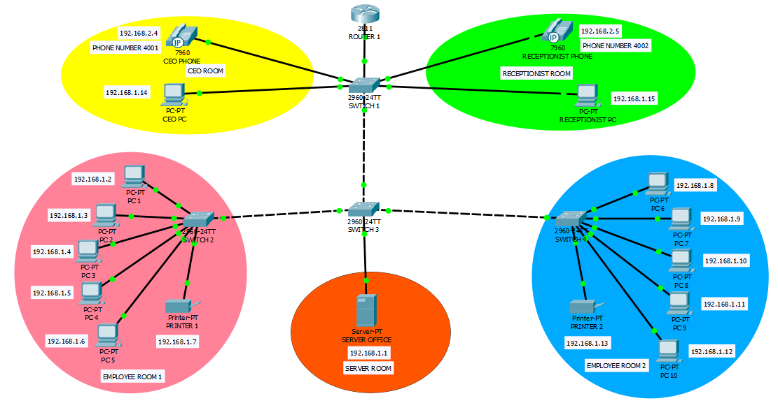
NETWORK SCHEME

Slide 10
Software & Network Media
SOFTWARE
NETWORK MEDIA
In this specific Project, the Office’s network will require stability, reliability, and effectiveness. Based on that statement, the Network will use Windows 10 Professional as the Client Operating System, Windows Server 2016 for the Server’s Operating systems, and also Microsoft Office 365 to support employee’s activity.
The office will use only one network media, Wired. The wired network is required for connecting a room with another.

Slide 11
CONCLUSION AND SUGGESTION
CONCLUSION
SUGGESTION
Network is a Collection of devices that connected to one another, thus creating an integrated connection, in order to create a network, first thing is to overlook a Topology and the Architecture and decide the media and device used within the Network.
Even with the Complexity of the Network setup, it can not guaranteed 100% safety, to anticipate it is recommended for the Administrators to perform a weekly data backup, to anticipate the Network Failure caused by user error or a Natural Disaster.

Slide 12
THANK YOU ☺
ANY QUESTIONS?

